Slide 1
Cryptocurrency Analysis
2018

Slide 2
HISTORY & EVOLUTION
1998 – 2009 The pre-Bitcoin years
Although Bitcoin was the first established cryptocurrency, there had been previous attempts at creating online currencies, two examples of these were B-Money and Bit Gold, which were formulated but never fully developed.
In 2009, a paper called Bitcoin – A Peer to Peer Electronic Cash System was posted to a mailing list discussion on cryptography, by Satoshi Nakamoto, whose real identity remains a mystery.
In 2010, Bitcoin is finally valued, then in 2011 rivals appear (Namecoin & Litecoin) which led to Bitcoin crash in 2013.
Ehereum appears in 2016

Slide 3
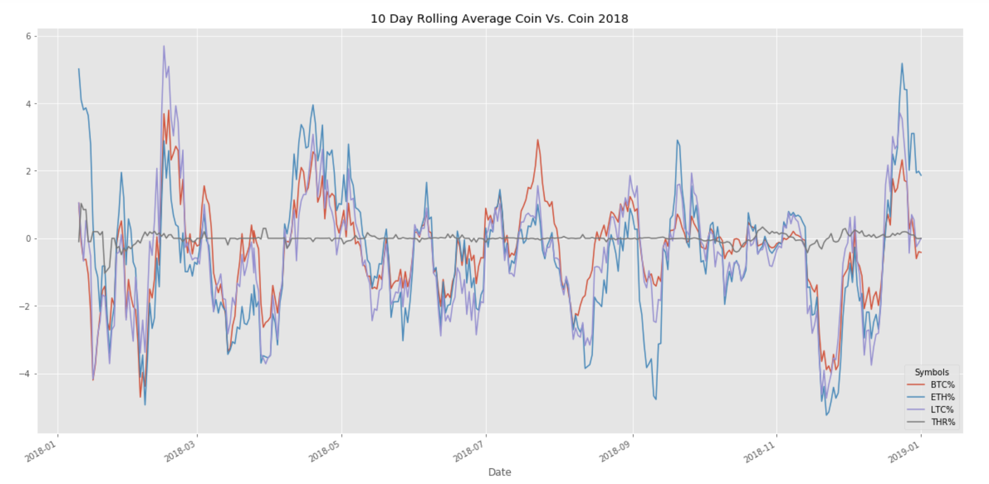
Coin vs. Coin Comparisons
Daily Coin Percent of Change
Mean % Change 2018
BTC% -3.395422e-01
ETH% -4.556945e-01
LTC% -5.310612e-01
ANOVA:
Coin vs. Coin P-Value = 0.2500
P-Value W/ Tether = 1.7157990391769624e-07

Slide 4
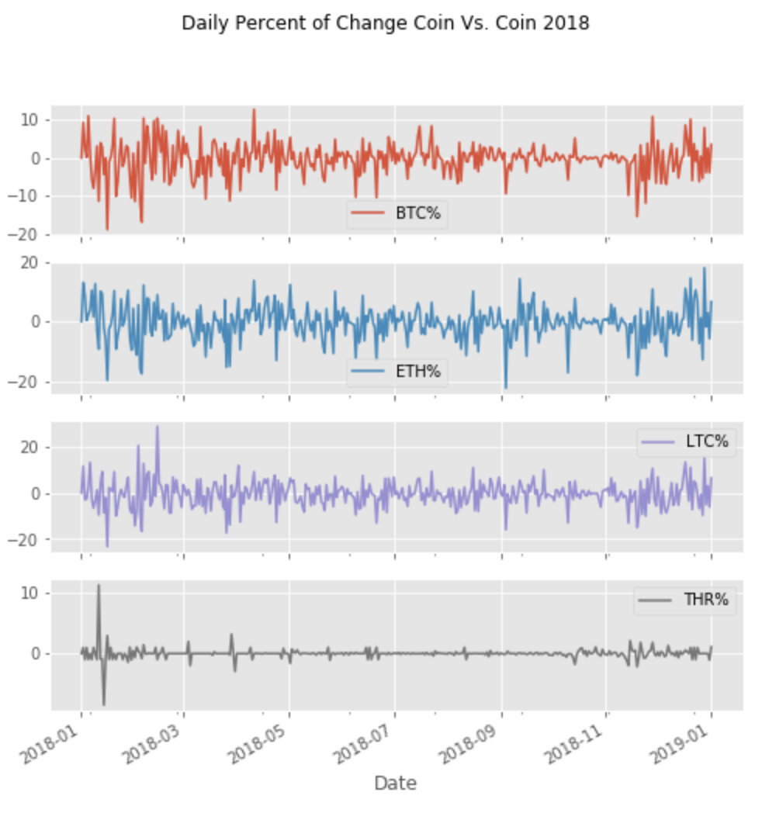
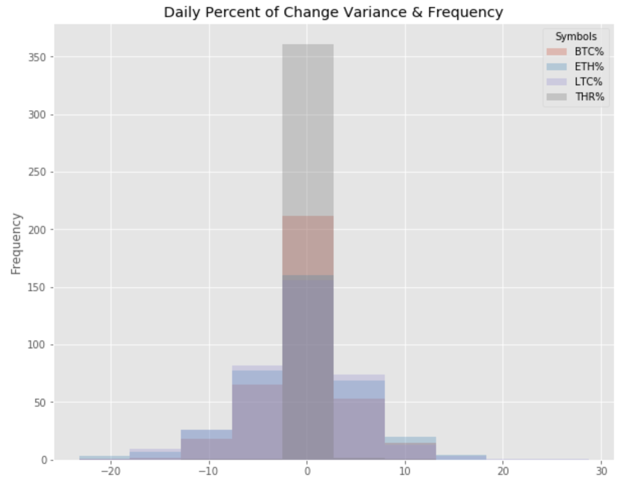
Coin vs. Coin Comparisons
Variance Between Coins?
Wild daily variances observed from +30% to -25%
Note Tether (USD) stays very consistent with minimal change

Slide 5
SHARP RATIO S&P VS CRYPTOS
First bullet point here
Second bullet point here
Third bullet point here
Class | Group 1 | Group 2
Class 1 | 82 | 95
Class 2 | 76 | 88
Class 3 | 84 | 90

Slide 6
HEDGING
Step 1 Title
Task description
Task description
Step 2 Title
Task description
Step 3 Title
Task description
Task description
Task description

Slide 7
Add a Slide Title - 1

Slide 8
Add a Slide Title - 2

Slide 9
Add a Slide Title - 3

Slide 11
Add a Slide Title - 4

Slide 12
Add a Slide Title - 5

